Slide 1
few-shot learning
Presented by : mohammad khalili

Slide 2
What is few-shot learning
Learning from a few data points is called few-shot learning or k-shot learning, where k specifies the number of data points in each of the class in the dataset
If we have, say, 11 images of an apple and 11 images of an orange, then that is called 11-shot learning So, k in k-shot learning implies the number of data points we have per class.

Slide 3
Zero-shot learning
zero-shot learning, where we don't have any data points per class. Wait. What? How can we learn when there are no data points at all? In this case, we will not have data points, but we will have meta information about each of the class and we will learn from the meta information.
Since we have two classes in our dataset, that is, apple and orange, we can call it two-way k-shot learning. So, in n-way k-shot learning, n-way implies the number of classes we have in our dataset and k-shot implies a number of data points we have in each class

Slide 4
Say we have a dataset, . We sample a few data points from each of the classes present in our dataset and we call it support set. Similarly, we sample some different data points from each of the classes and call it query set.
We train the model with a support set and test it with a query set.

Slide 5
Siamese networks
one-shot learning is a technique where we learn from only one training example per each class. So, siamese networks are predominantly used in applications where we don't have many data points for each of the class.
Siamese networks basically consist of two symmetrical neural networks both sharing the same weights and architecture and both joined together at the end using an energy function

Slide 6
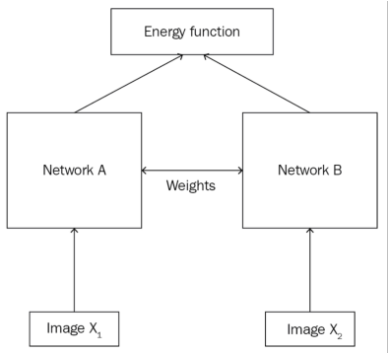
we can use a convolutional network to generate the embeddings: that is, for extracting features. Remember that the role of the CNN here is only to extract features and not to classify
As we know that these networks should have same weights and architecture, if Network is a three-layer CNN then Network should also be a three-layer CNN, and we have to use the same set of weights for both of these networks.
Siamese networks are not only used for face recognition, but are is also used extensively in applications where we don't have many data points and tasks where we need to learn the similarity between two inputs. The applications of siamese networks include signature verification, similar question retrieval, and object tracking

Slide 7

Let's say we use Euclidean distance as our energy function; then the value of will be low if and are similar. The value of will be large if the input values are dissimilar.

Slide 8
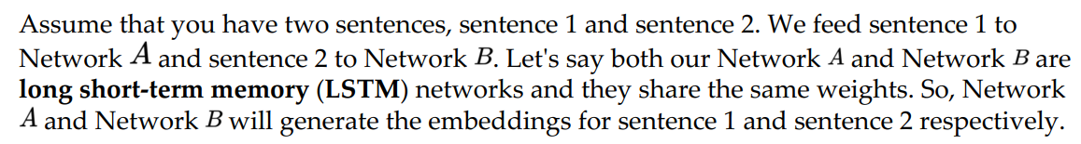
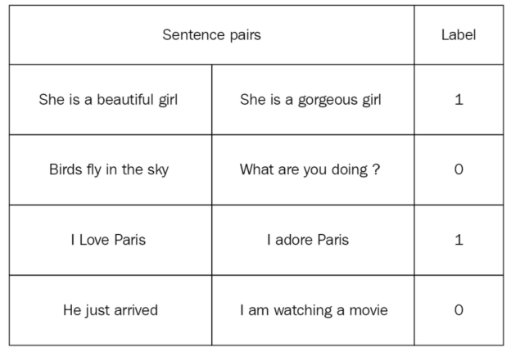
we have sentences as pairs and the label implies whether the sentence pairs are genuine (1) or imposite (0)

Slide 9
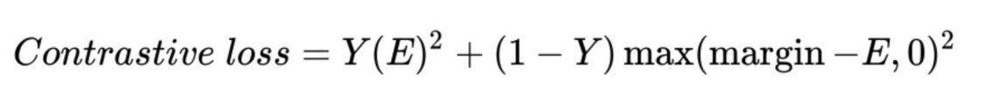
loss function of our siamese network
the value of is the true label, which will be 1 if the two input values are similar and 0 if the two input values are dissimilar, and is our energy function, which can be any distance measure. The term margin is used to hold the constraint, that is, when two input values are dissimilar, and if their distance is greater than a margin, then they do not incur a loss

Slide 10
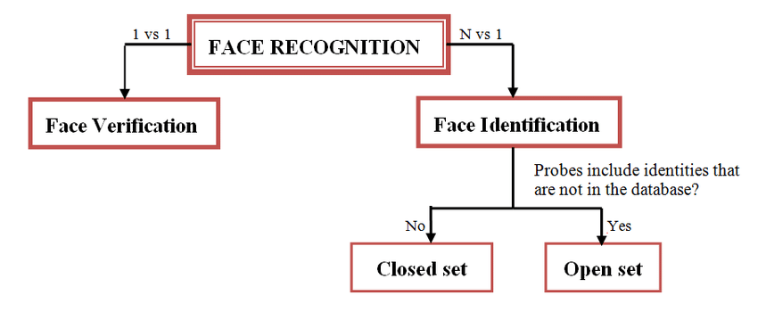
Closed Set Face Recognition
Every query face image belongs to one of the known individuals in the gallery
Open Set Face Recognition
Query face images may include individuals not present in the gallery set.
brendenlake/omniglot: Omniglot data set for one-shot learning (github.com)
Reptile: A scalable meta-learning algorithm | OpenAI

Slide 11
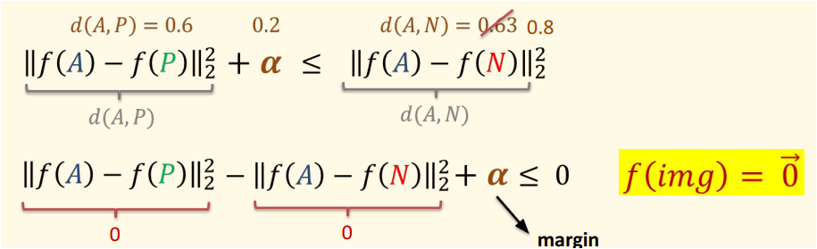
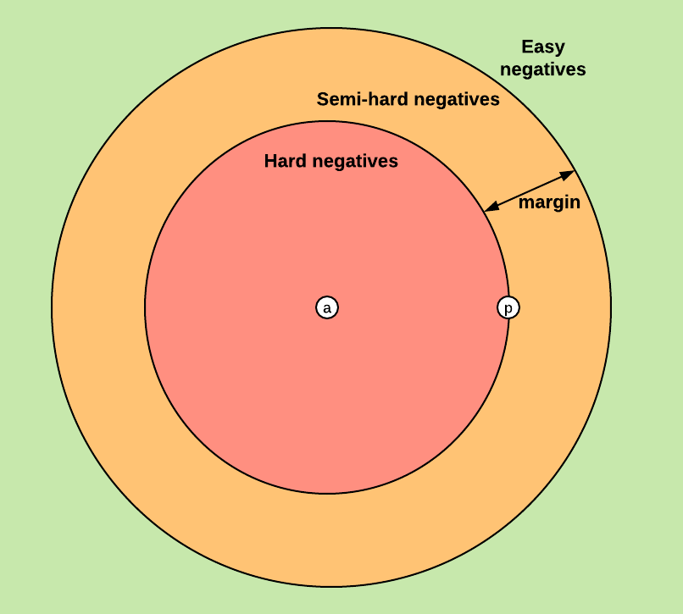
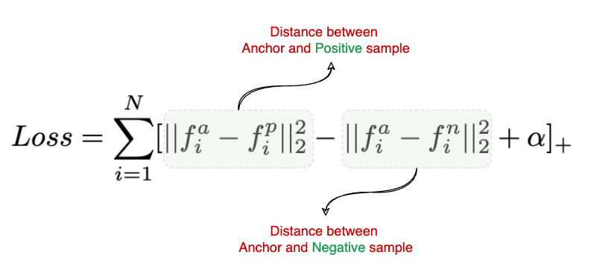
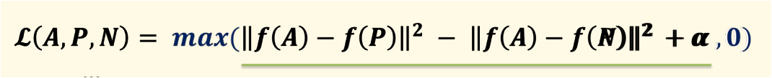
Triplet loss

Slide 12
Center loss
center loss indeed helps in producing more compact features for each class
particularly in the field of face recognition and image classification, to enhance the discriminative power of the learned features. It works by reducing the intra-class variance while keeping the features of different classes separable

